Slide 1
Budweiser Case Study
by Megan Riley and Edgar Nunez

Slide 2
Key Question: How many breweries are in each state?
Overall States such as California and Colorado dominate with 47 and 39 local breweries, respectively. But many states have over 10 breweries statewide.
Focusing on one or two states would limit potential market share.

Slide 3
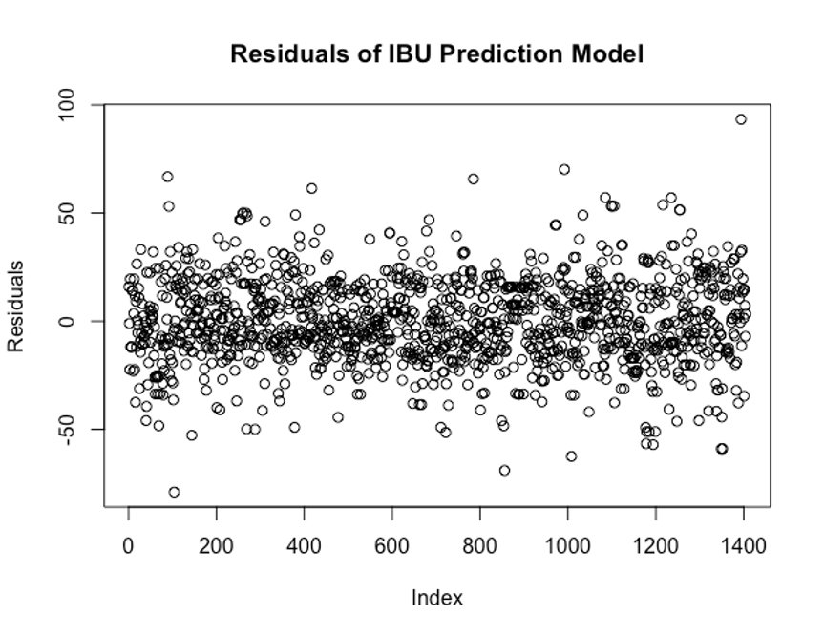
Key Question: Missing Data in the IBU Column
We ran an initial investigation to predict the IBU values based on the paired Alcohol by Volume (ABV) values of the beer as 41% of International Bitterness Units (IBU) values were missing in the original data.
The linear model used is not perfect and
leaves a lot of IBU variation unexplained, with increasing IBU variance as ABV increases.

Slide 4
Key Question: Missing Data
After the data is imputed with a linear model the general shape of the IBU data values changes.
Furthermore by basing imputed IBU values on ABV values future analysis on the relationship between the two variables will be affected.
The 62 final missing values in IBU and ABV are imputed with the median and should not heavily change the distribution.

Slide 5
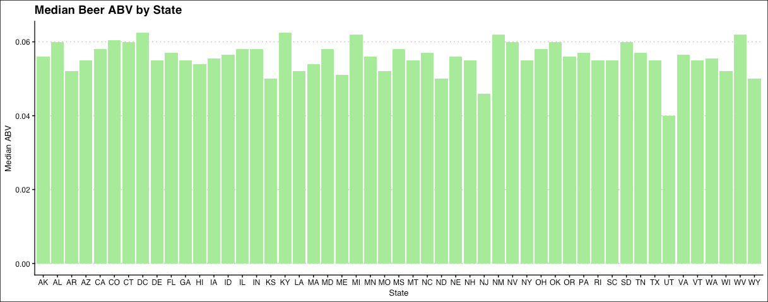
Key Question: What is the Median ABV by State?
Overall most states have similar Median ABV's.
Notably Utah's Median ABV is lower than most others.

Slide 6
Key Question: What is the Median IBU by State?
The first graphic represents the original distribution of Median IBU by state. This does not include missing values.
The second graphic includes imputed IBU values which changes the variance in IBU by State.
Maine seems to have diminished greatly in Median IBU

Slide 7
Key Question: Which State has the most alcoholic beer? Which has the most bitter?
Colorado has the most alcoholic beer in our records.
The beer is called Lee Hill Series Vol. 5, it is a Belgian Style Quadruple Ale; it is brewed by Upslope Brewing Company, and it has an ABV of .128
The most bitter beer in our records is Bitter Bitch Imperial IPA; it is Brewed by Astoria Brewing Company in Oregon, and it has a strong 138 IBU.

Slide 8
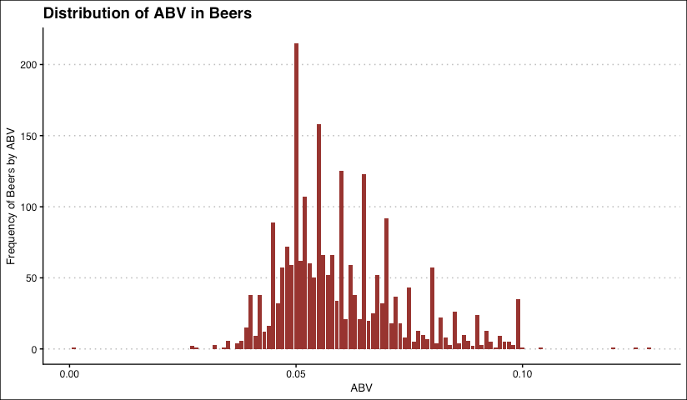
Key Question: Discussing the distribution of ABV in beers
In general, ABV in beers displays a right skewed distribution, where most beers fall within .05 and .10 ABV.
The minimum ABV value is .001, which is almost non-alcoholic.

Slide 9
Key Question: The relationship between IBU and ABV
The following images display a strong positive linear correlation between IBU and ABV. However there is significant variance in IBU distribution as ABV increases.
This variance is somewhat diminished in the current data set, as shown in the blue scatter plot; this graph includes imputed values based on a linear regression model and some values were imputed with the mean.
Violation of
homoscedasticity assumption

Slide 10
Key Question: Can we differentiate IPAs from Ales by IBU and ABV?
We determined the best approach for this analysis is through a KNN(K- Nearest Neighbors) classification algorithm.
These two graphs show the different grouping or classifications of IPAs and Ales based on IBU by ABV.

Slide 11
Key Question: Can we differentiate IPAs from Ales by IBU and ABV?
We ran the KNN analysis with 80% of the data as a training set.
The resulting model correctly differentiated between IPA and Ale beers 81% of the time.
The graph shows the true classification and how the clusters overlap; there is also evidence of potential influence by the IBU imputation.

Slide 12
Key Question: Can we differentiate IPAs from Ales by IBU and ABV?
The resulting KNN model has an 81% accuracy with 89% specificity and 68% sensitivity.
The graph shows the numbers of correctly predicted (diagonal) and incorrectly predicted (off-diagonal) Ales and IPAs. Ale predictions were higher than IPAs predictions, probably due to the higher variety of Ales.

Slide 13
Next Steps in Analysis
Accessing beer consumption rates by state will complement the production data we have, and provide new insight to help identify business opportunities, where Budweiser may benefit by adding local beer production.
In this heat map we can observe the distribution of consumption per capita, in thousands of gallons per state.
Some of the northernmost states, like Montana, North Dakota, and New Hampshire are heavy consumers.

Slide 14
Average Per Capita Consumption of Alcohol in Beer
Per Capita consumption of beer is only part of the consumption story. By combining average ABV per state with our per capita beer consumption, we can see the actual average alcohol consumption per state.
i.e.: Nevada stands out more here than previously as it has a higher average ABV.

Slide 15
Producing and Consuming States
Finally we can combine the amount of beers produced by state with beer consumption per capita.
The resulting statistic gives us insight of state’s local beer production vs. consumption.
The states with lighter color consume more beer than the supply provided by local production. The darker states produce more been than what the state consume.

Slide 16
Thank You

